Slide 1

Olympics
By:
NaveeN KUMAR PAKA KIRIT KUMAR REDDY GAJARI

Slide 2
motivation
We have a lot of interest and passion towards automobile industry and a special interest towards a four wheeler. We are more interested what the new brands are expected in the market and will observe the salient features of the car. This interest made us to create an ontology for it.
Each and every car has it’s own uniqueness like the model, type, color etc., which defines a beauty of a car.

Slide 3
INTRODUCTION
The main objective of this ontology is to create a knowledge base for car.
Ontology is defined as description of concepts in a particular domain of interest.
The main components of ontology are classes, object properties, data properties.
The object properties defines the relationship between the classes and the data properties

Slide 4
Defined components
Classes
Object properties
Data properties
Onto graph

Slide 5
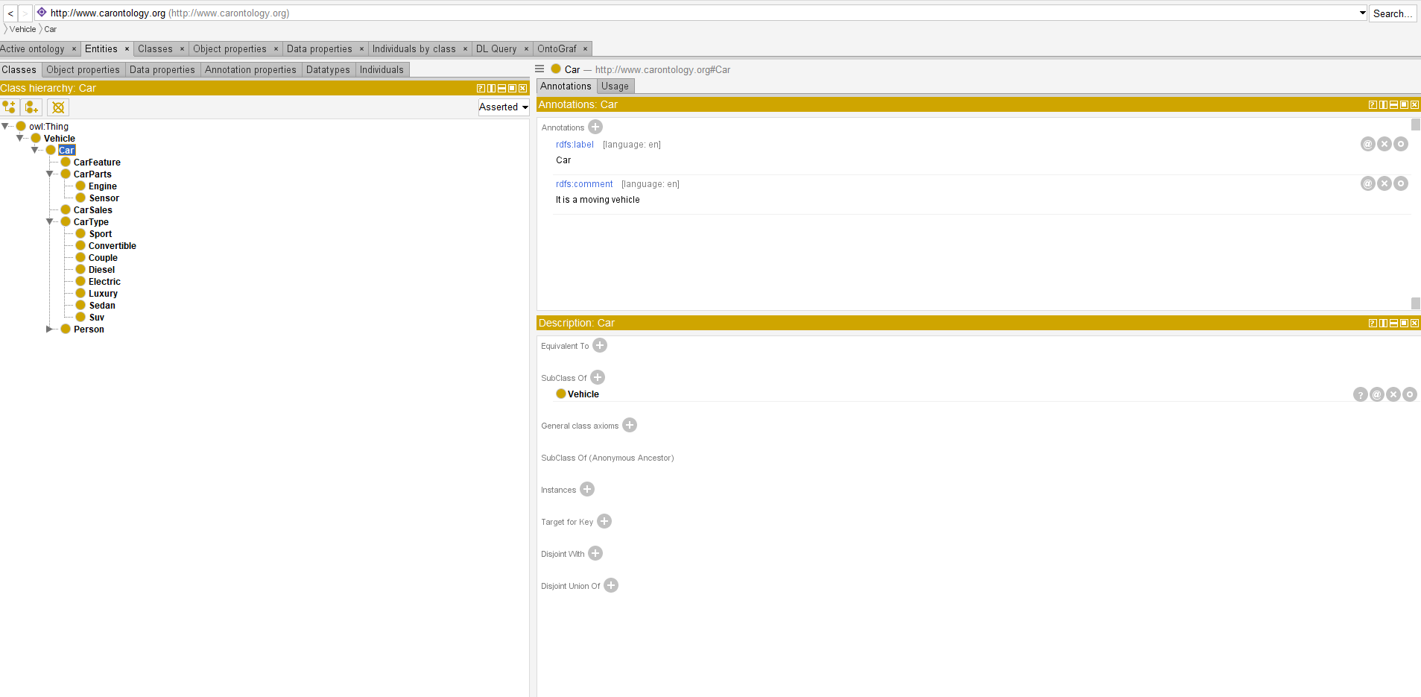
Class Hierarchy

Slide 6
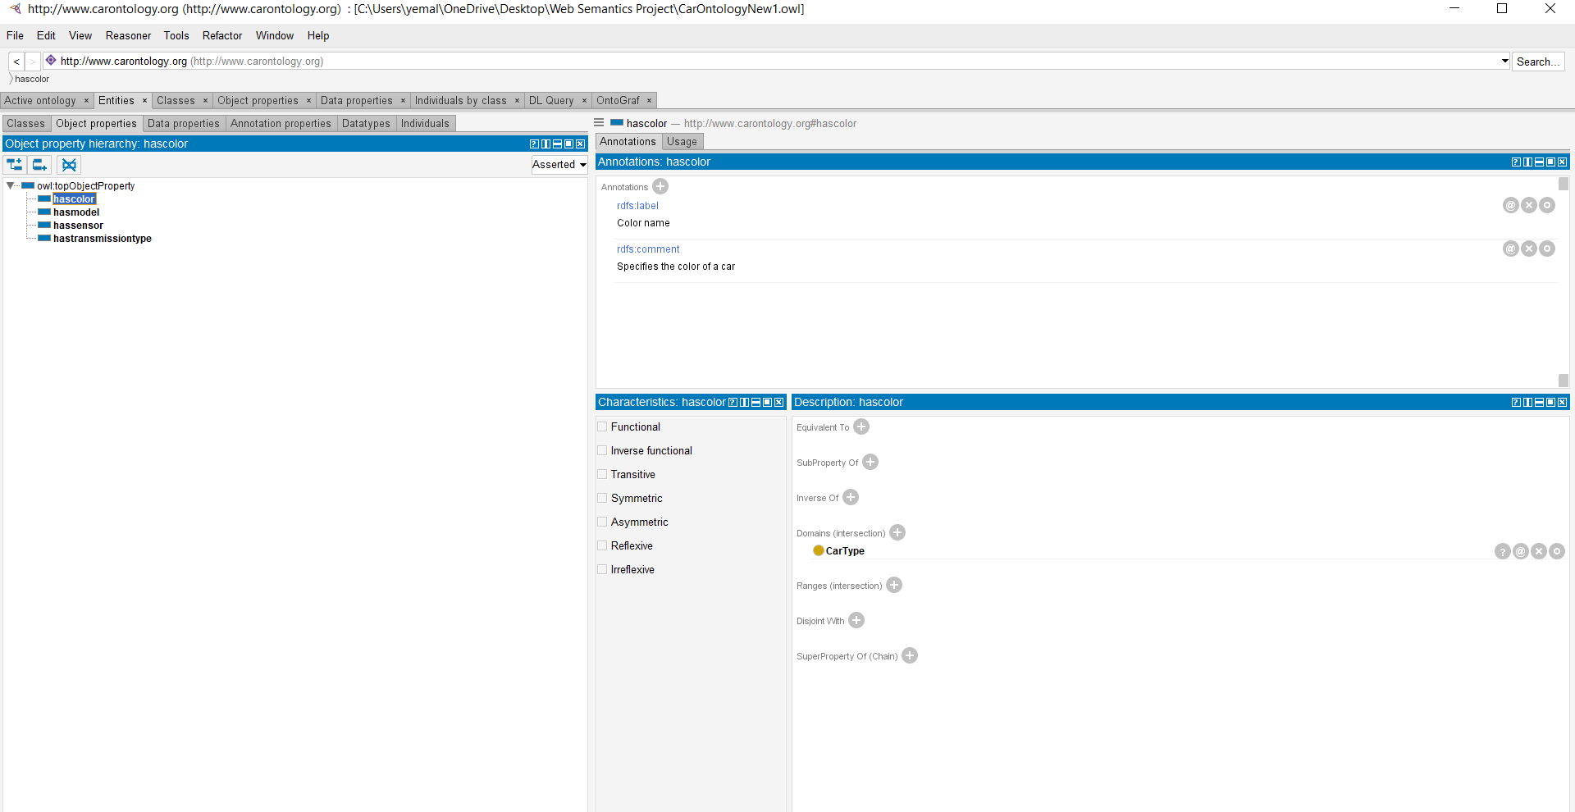
Object properties

Slide 7
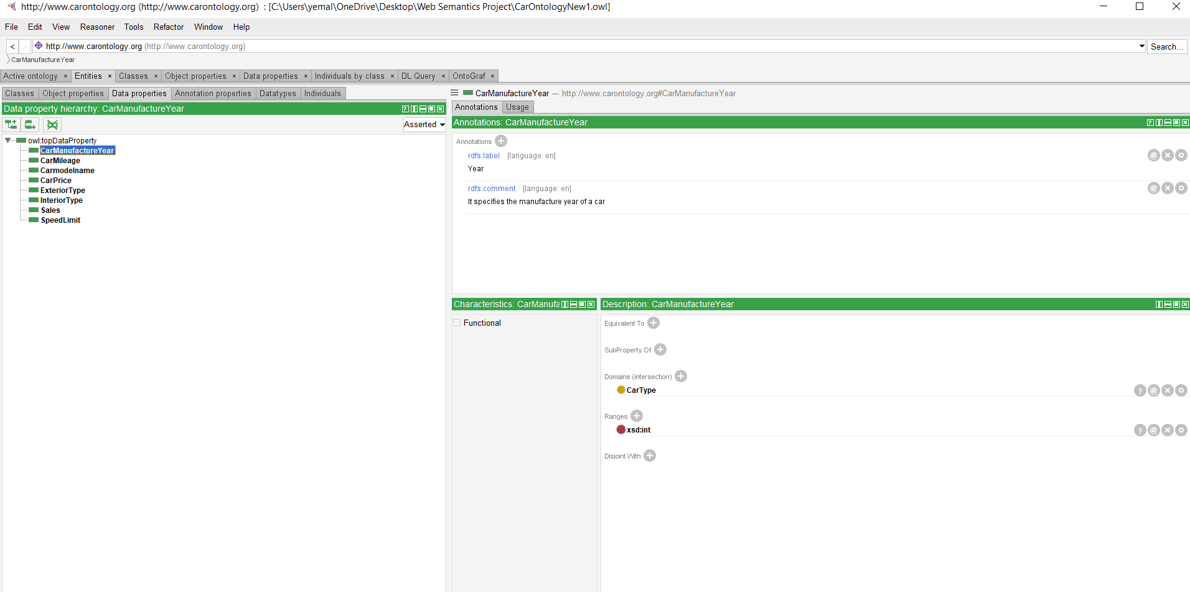
Data properties

Slide 8
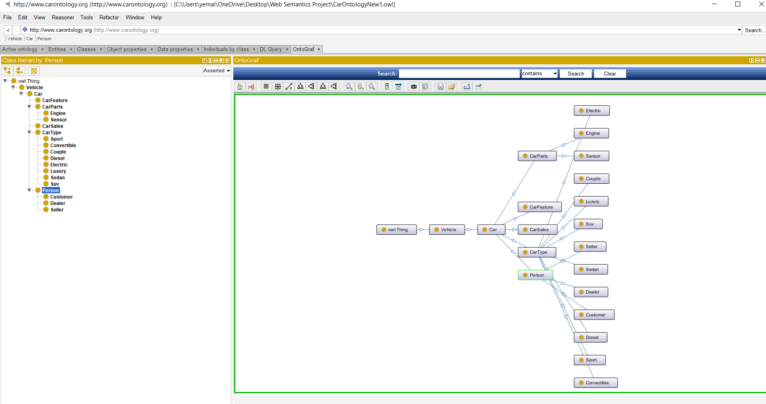
Onto Graph

